Slide 1
Chapter 9

Slide 2
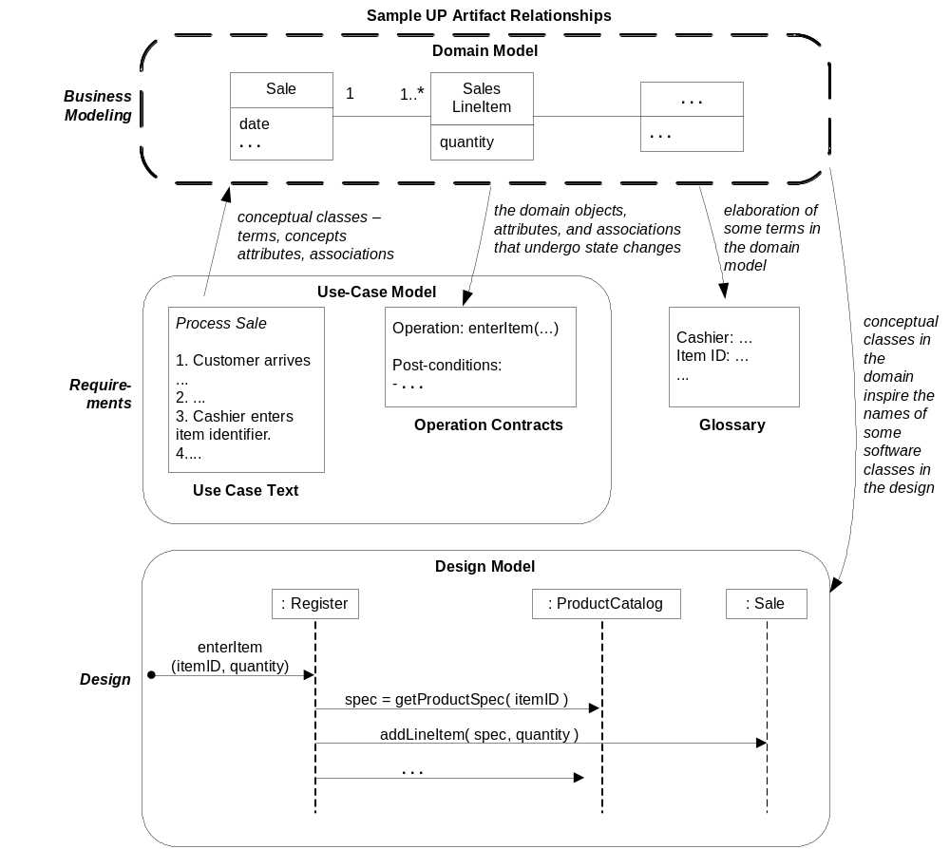
UP Artifact influence

Slide 3
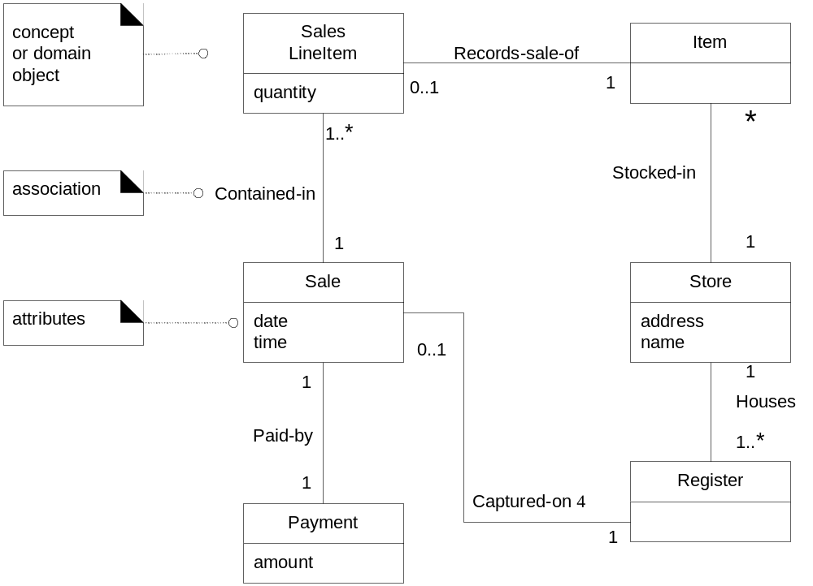
Partial Domain Model

Slide 4
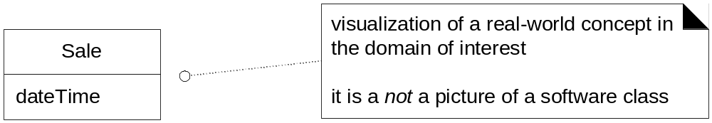
Conceptual Class

Slide 5
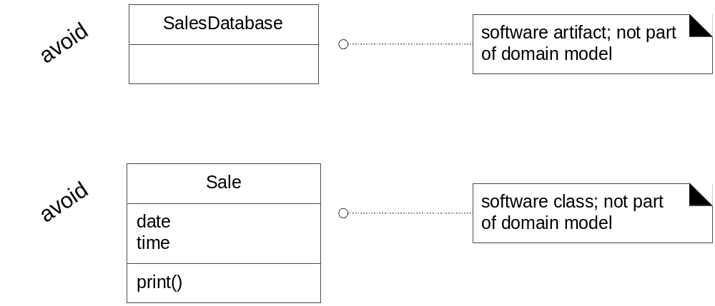
Domain Model not artifacts or classes

Slide 6
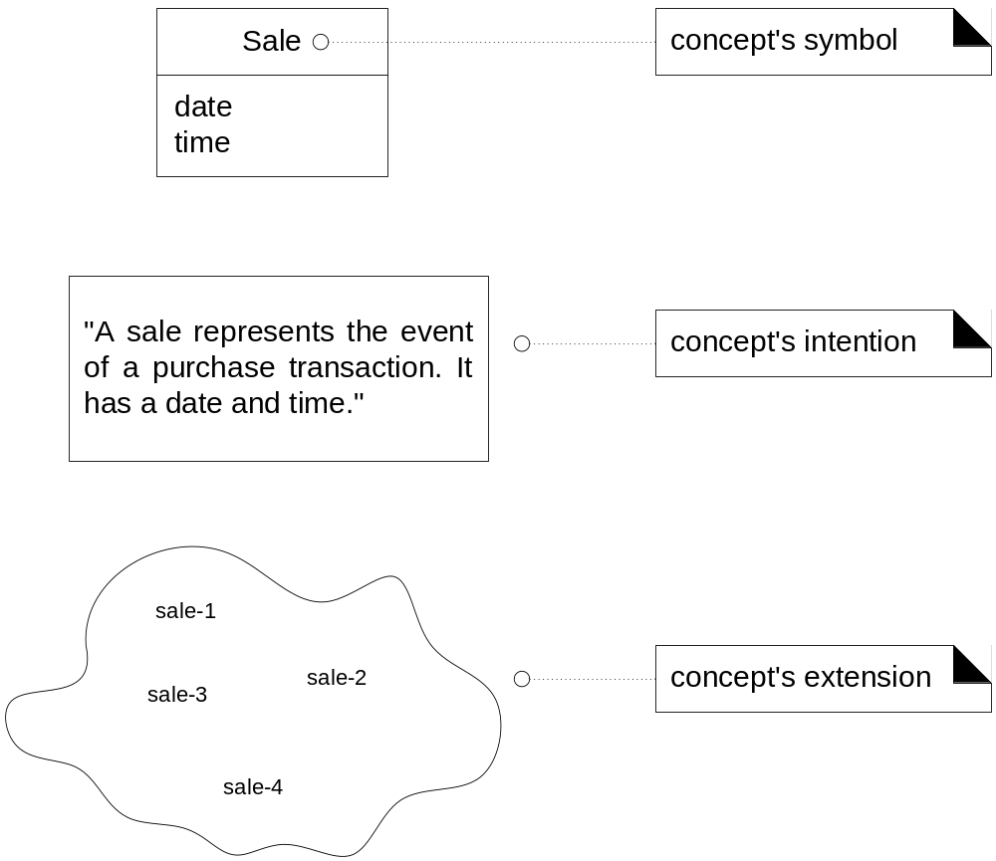
Symbol, Intention and Extension

Slide 7
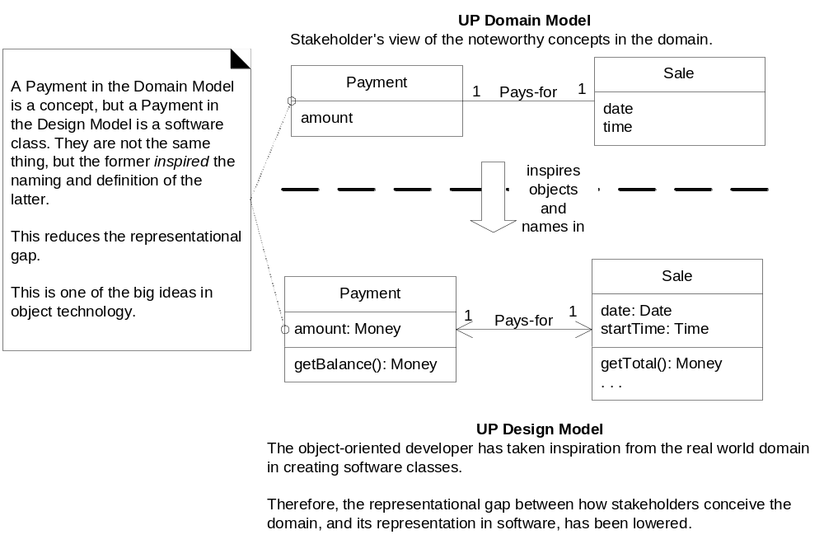
Reducing Representational Gap

Slide 8
Creating Domain Model
Find conceptual classes
Draw them as classes in UML
Add association and attributes

Slide 9
Finding Conceptual Classes
Reuse or modify existing models
Use a category list
Identify noun phrases

Slide 10
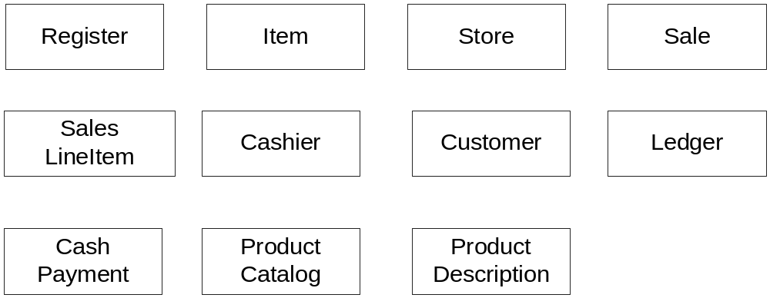
Initial POS domain

Slide 11
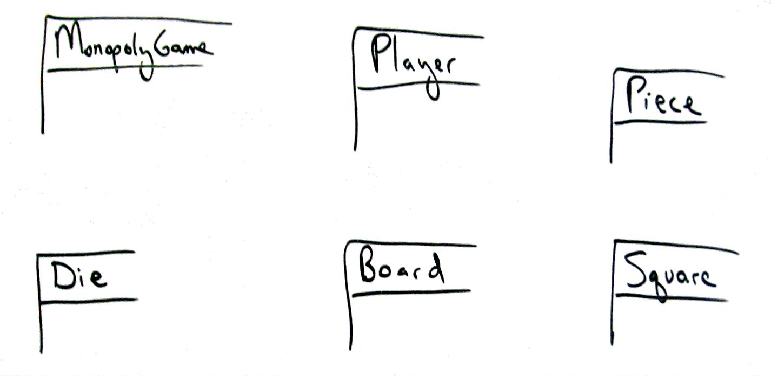
Fig. 9.8

Slide 12
Mistakes in representation Attributes vs Class
Avoid representing a class as an attribute
  Store attribute for Sale?
  Destination attribute for Flight?

Slide 13
Product Description Class
Description class: contains description about something
Not the actual product Item but just a description
  If its part of an item as the item inventory decreases to zero the product information is lost
  Price, picture, description

Slide 14
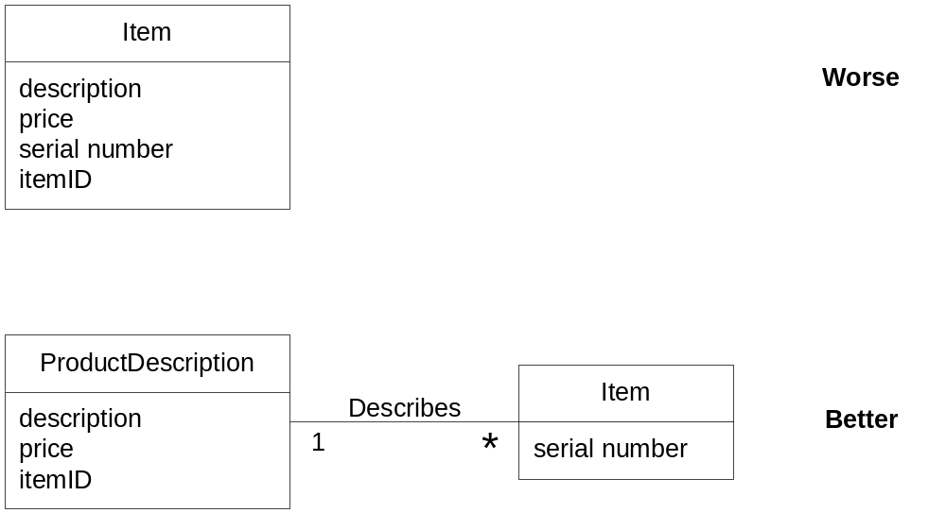
Fig. 9.9

Slide 15
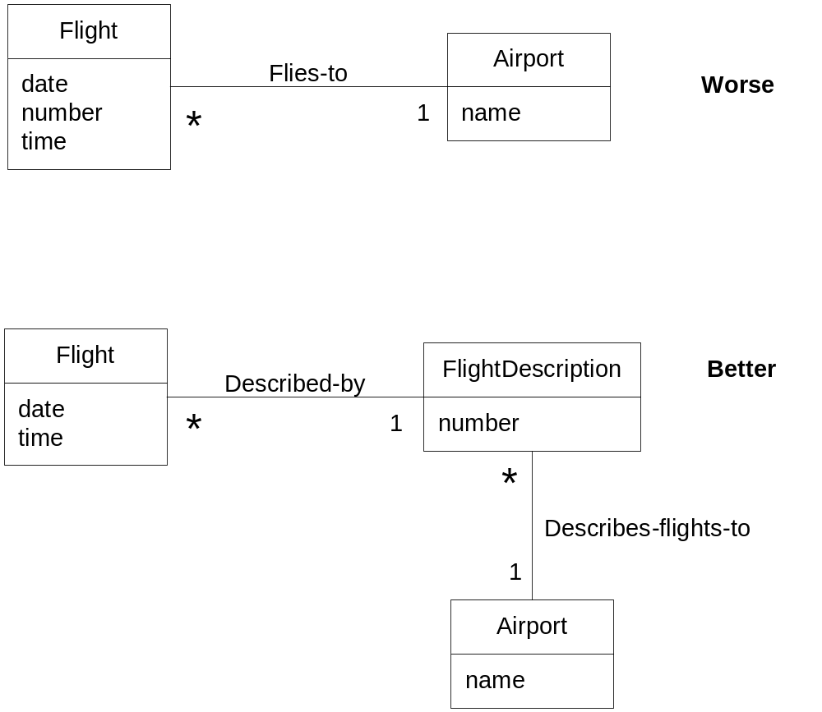
Description of product or service

Slide 16
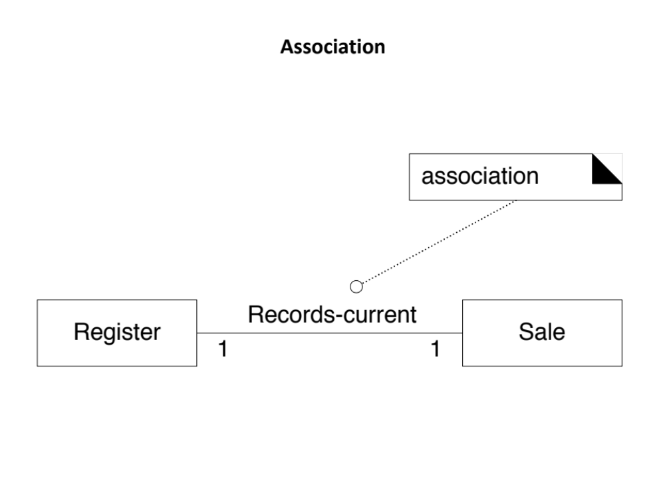
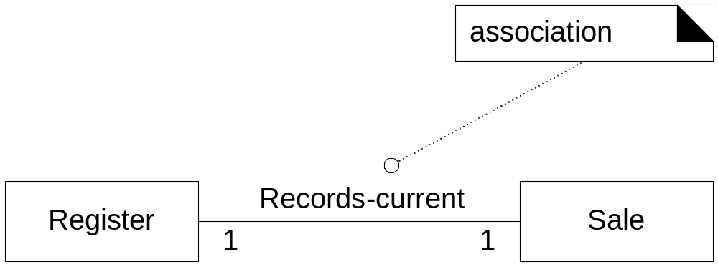
Association

Slide 17
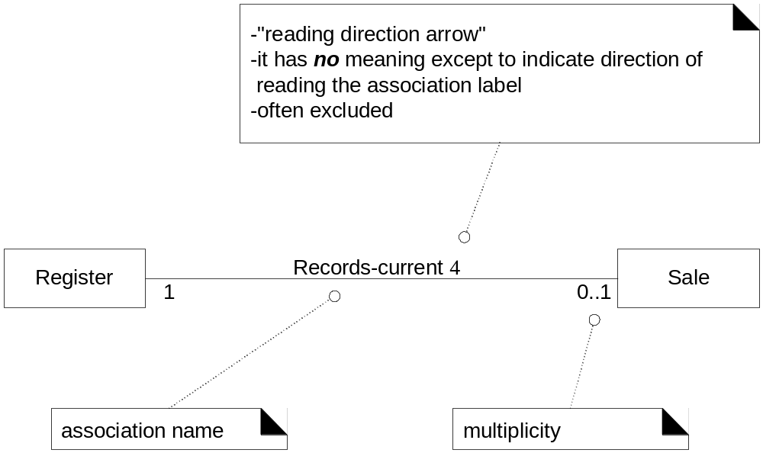
Associations (contd.)

Slide 18
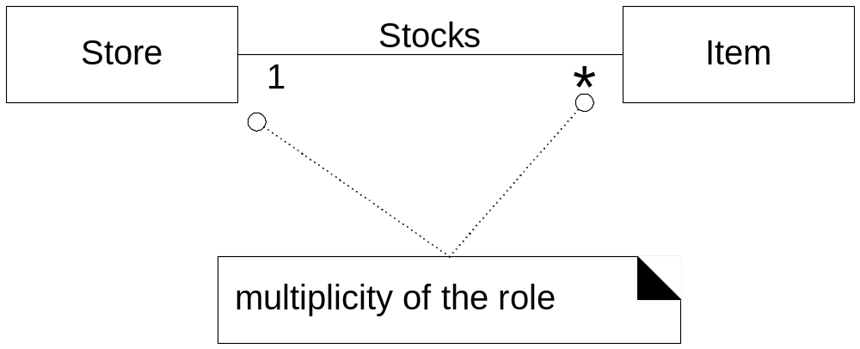
Multiplicity

Slide 19
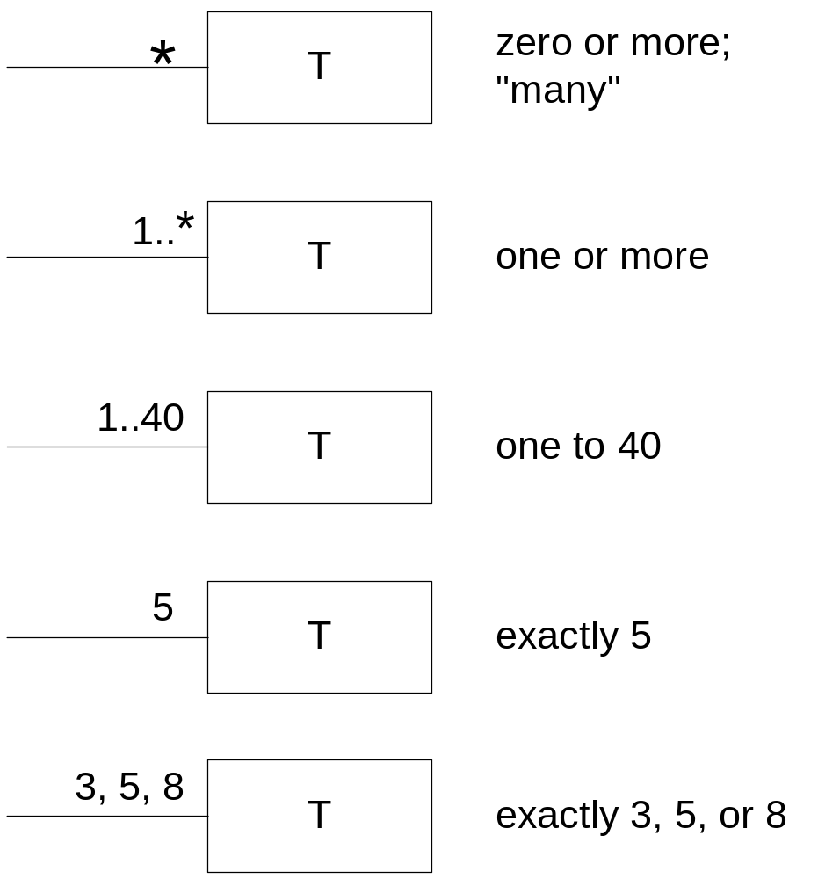
Fig. 9.14

Slide 20
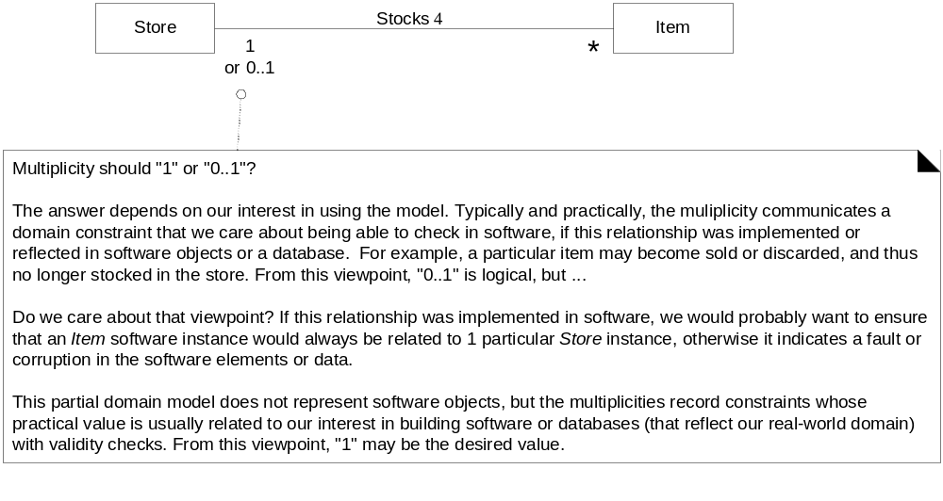
Context dependent multiplicity

Slide 21
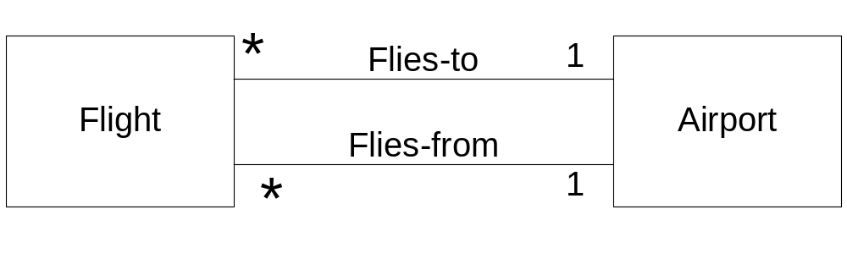
Multiple associations

Slide 22
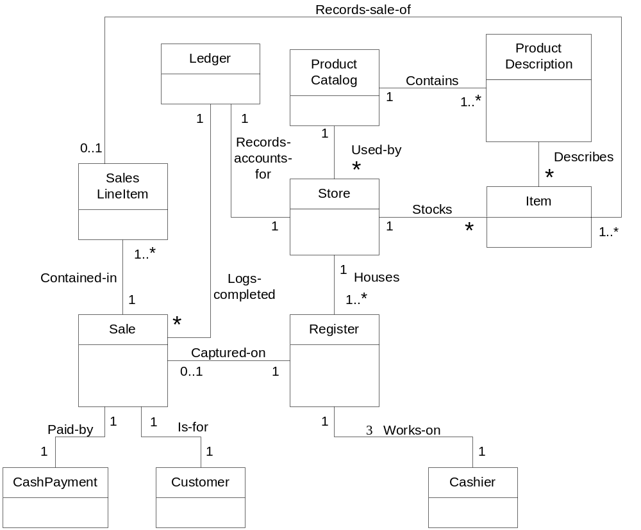
Fig. 9.17

Slide 23
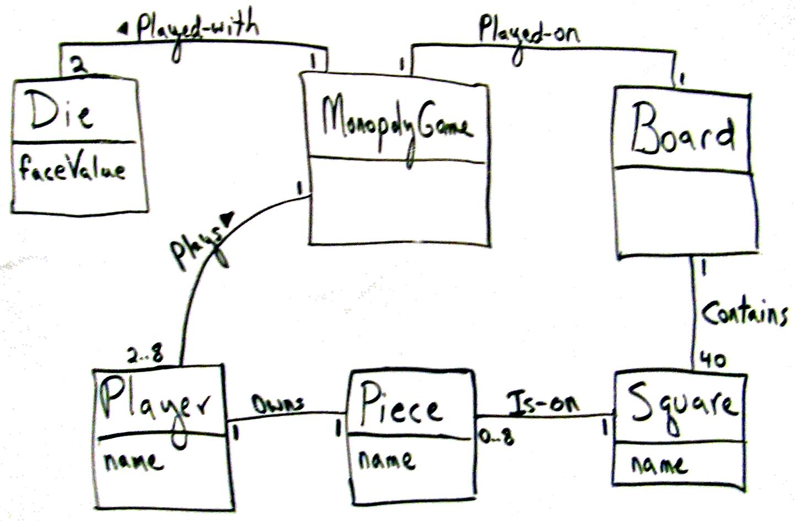
Fig. 9.18

Slide 24
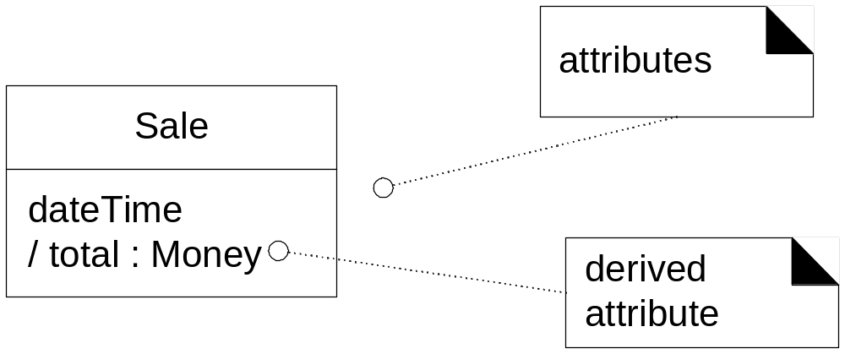
Attributes

Slide 25
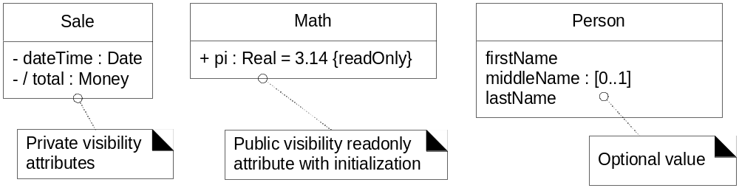
Attributes (contd.)

Slide 26
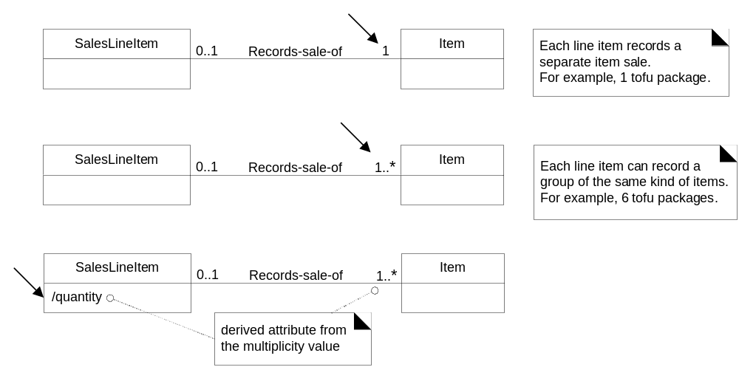
Attributes (contd.)

Slide 27
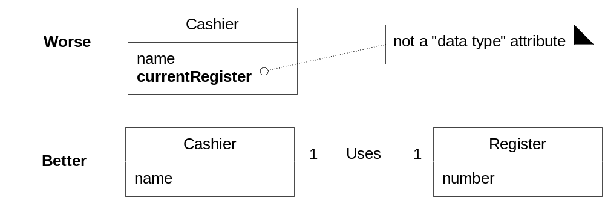
Attribute Types

Slide 28
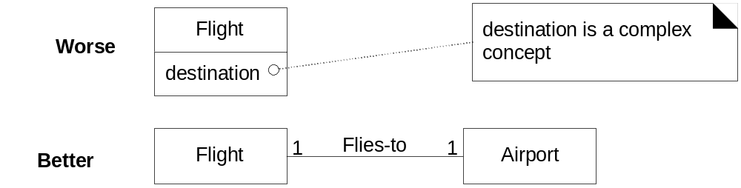
Attribute Types (contd.)

Slide 29
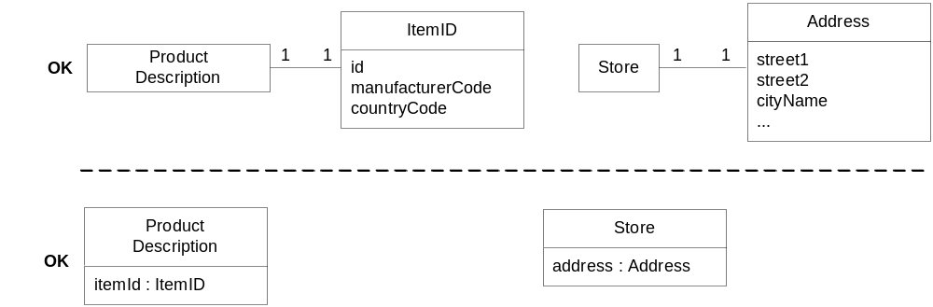
Fig. 9.24

Slide 30
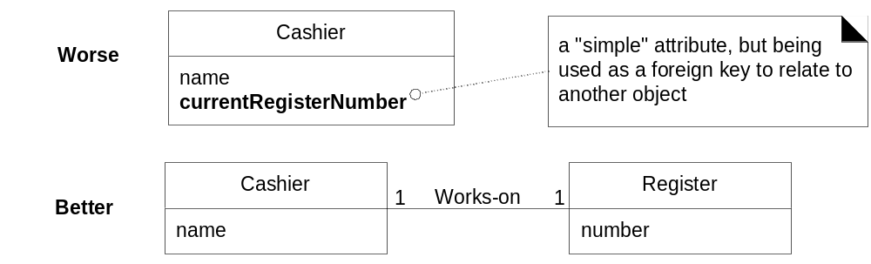
Fig. 9.25

Slide 31
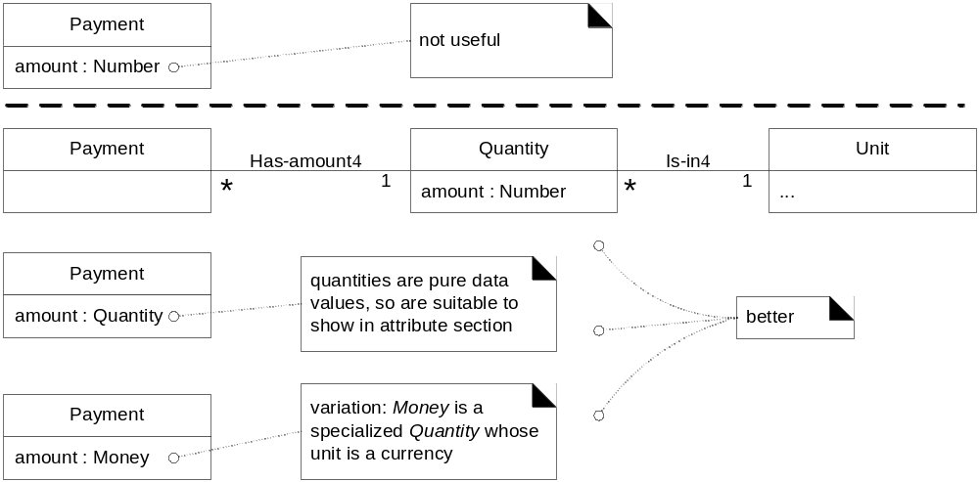
Fig. 9.26

Slide 32
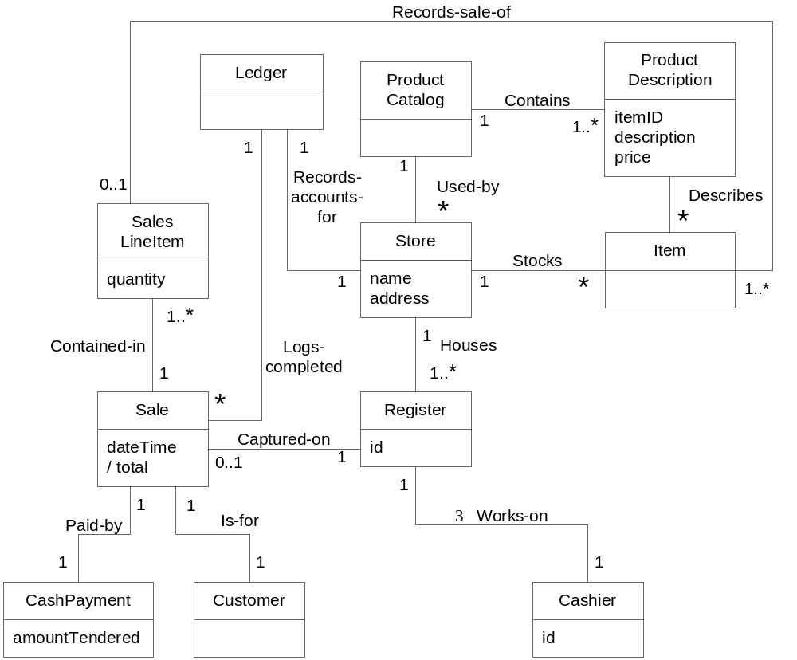
Fig. 9.27

Slide 33
Fig. 9.28

